Slide 1
Do enhancer-associated intergenic long noncoding RNAs contribute to nuclear architecture ?
Cyril Matthey-Doret
Supervised by : Jennifer Yihong Tan
Directed by : Ana Claudia Marques

Slide 2
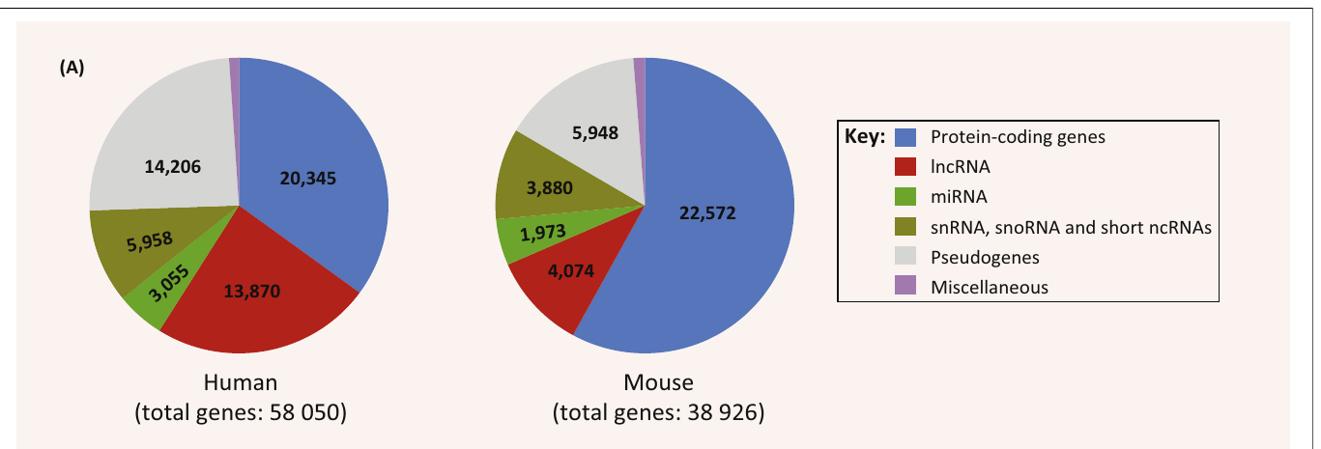
LncRNAs
Long noncoding RNAs
Defined based on length : >200bp
Largest class of noncoding transcript in the human genome
Atianand MK, Fitzgerald KA, 2014. Trends Mol Med.

Slide 3
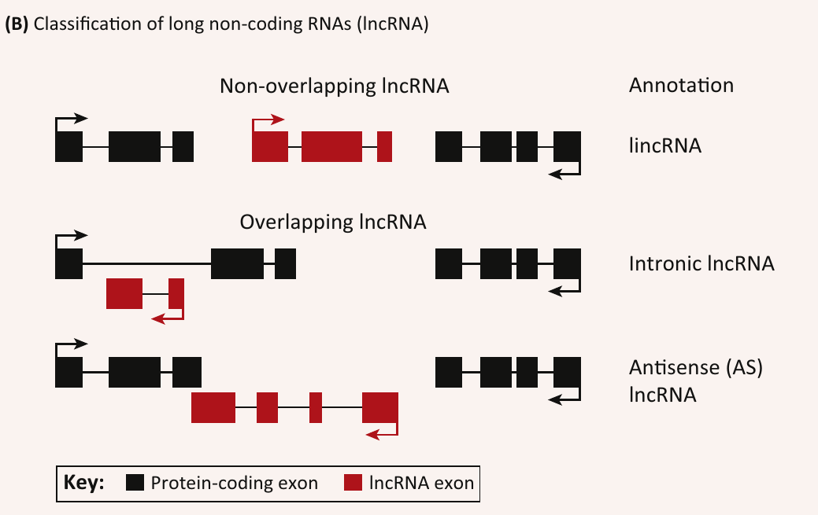
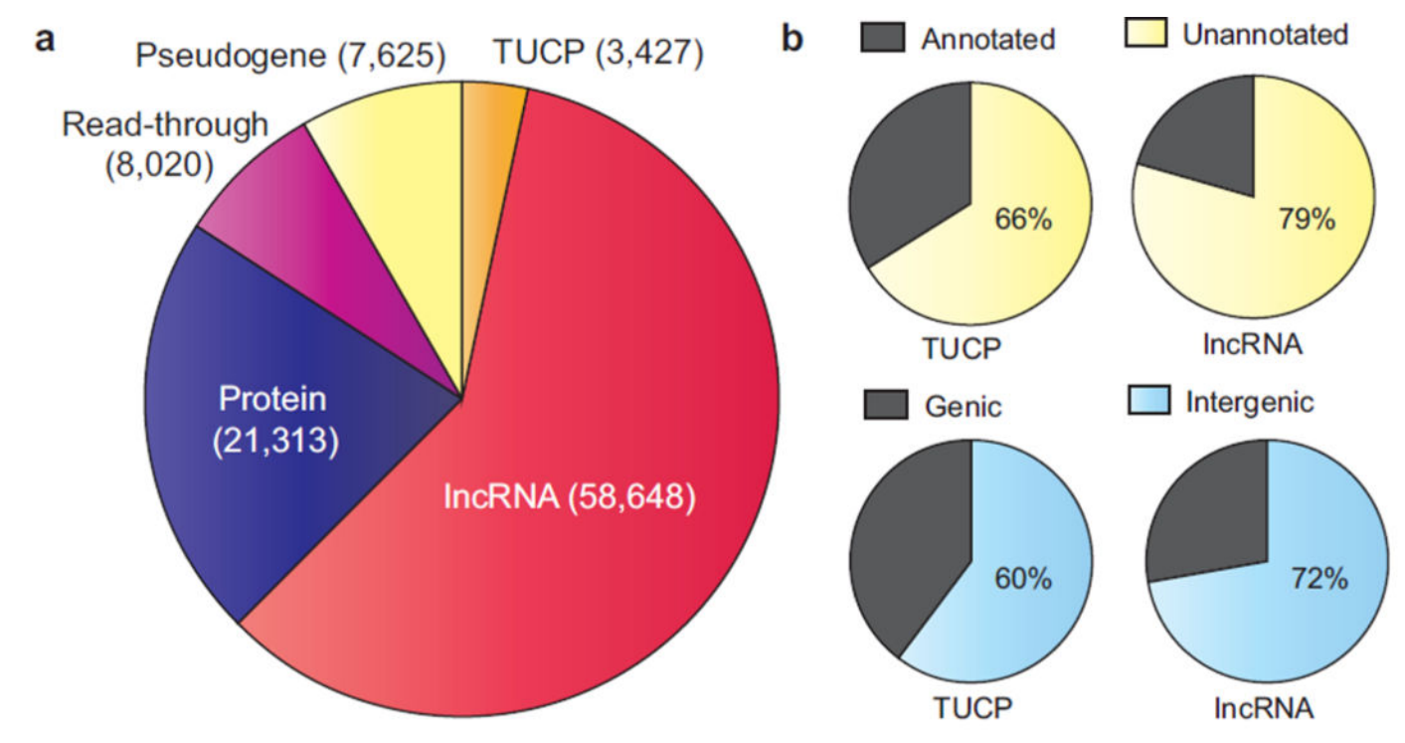
LincRNAs
Long intergenic noncoding RNAs
Do not overlap protein coding genes
Iyer MK et al., 2015. Nat Genet.
Atianand MK, Fitzgerald KA, 2014. Trends Mol Med

Slide 4
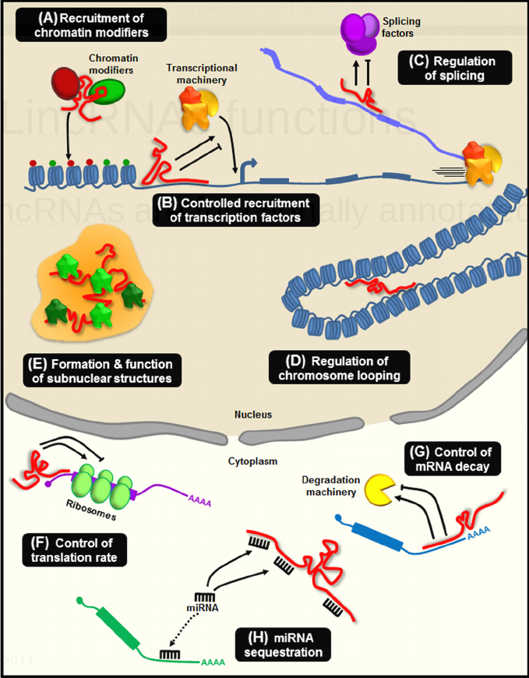
LincRNAs functions
Only 294* lncRNAs are functionally annotated
Wide variety of functions
* February 2016, http://www.lncrnadb.org/
Neguembor et al. Skeletal Muscle 2014

Slide 5
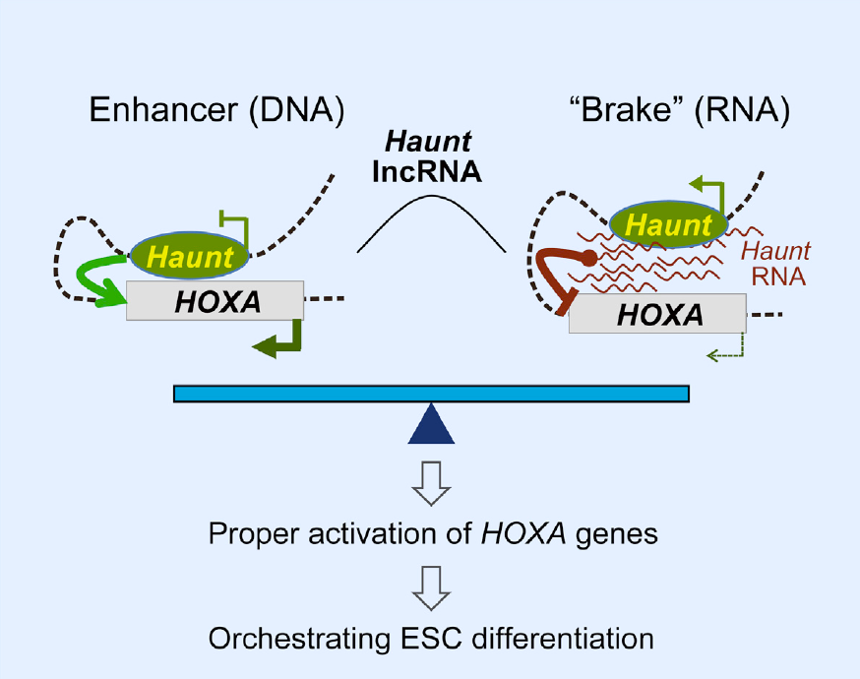
elincRNAs
Most active enhancers are transcribed
Some produce lincRNAs: elincRNAs

Slide 6
ElincRNAs can regulate genome architecture
elincRNAs associated with human traits
Regulate protein-coding genes in cis
Associated with regions of higher chromosomal interactions
Involved in the regulation of nuclear architecture
Tan et al, under revision
Notes:
Results from Marques group

Slide 7
Project aim
Do all lincRNAs arising from enhancers have a role in the regulation of intrachromosomal contacts ?

Slide 8
ElincRNAs
LCL-expressed lincRNAs whose promoter region overlaps enhancers but no promoters
LincRNAs: LCL-expressed (Tan et al, under revision)
Enhancers, promoters: active in LCL, ENCODE data
Class | Overlap | Number
elinc | Enhancers only, no promoters | 236
other | Neither enhancers nor promoters | 1756

Slide 9
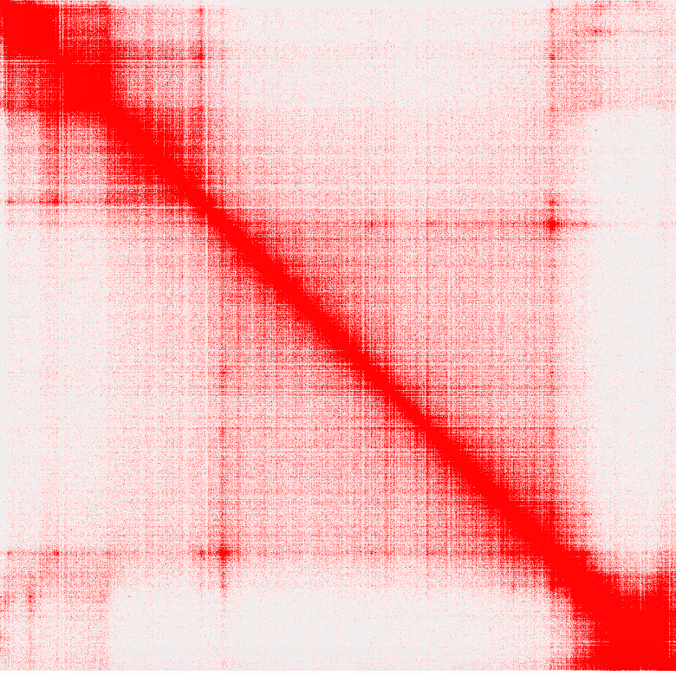
Hi-C technology
Genome-wide chromosome conformation capture
Allows to map all interactions in the genome
Rao et al, 2014. Cell

Slide 10
Hi-C technology
Genome-wide chromosome conformation capture
Allows to map all interactions in the genome
Topologically
Associated
Domains
Rao et al, 2014. Cell

Slide 11
Aim I
Are elincRNAs enriched in TAD regulatory regions ?
Rao et al, 2014. Cell

Slide 12
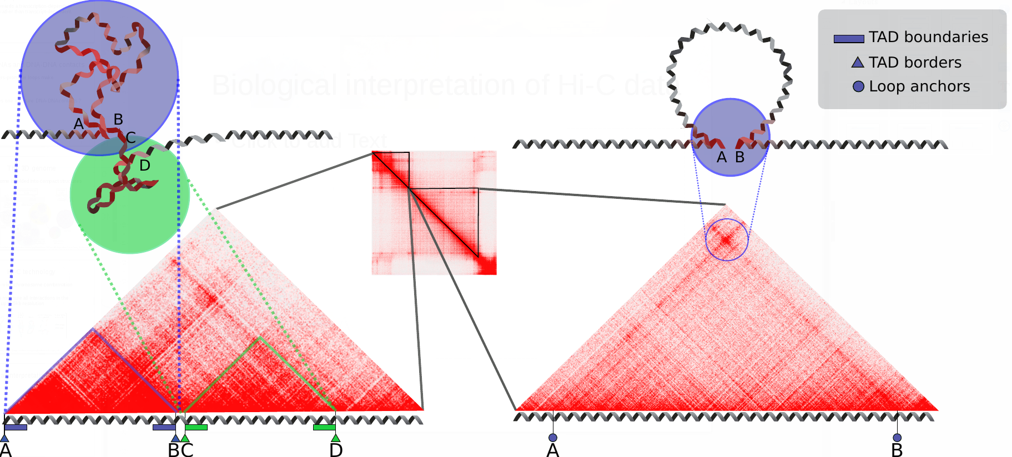
Chromatin structures
TADs and loops show distinct patterns

Slide 13
TAD boundaries
Maintaining the structure of TADs
CTCF
Cohesin

Slide 14
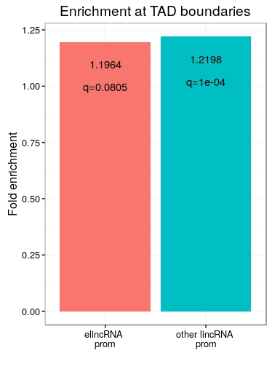
ElincRNAs are not enriched at TAD boundaries
Boundaries defined based on amount of DNA-DNA contact
Both elincRNAs and otherlincRNAs enriched at boundaries
ElincRNAs not significantly enriched compared to other lincRNAs.
q : p-value adjusted for multiple testing

Slide 15
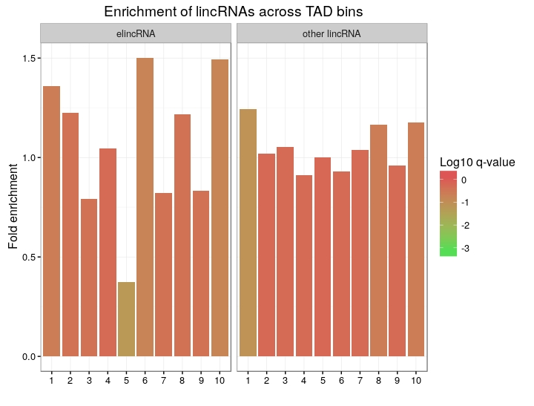
ElincRNAs are not enriched at TAD boundaries
Dividing TADs into 10 equally-sized bins.
No significant enrichment, but there is a trend.

Slide 16
ElincRNAs are not enriched at TAD boundaries
Dividing TADs into 10 equally-sized bins.
No significant enrichment, but there is a trend.
Strong depletion at the center
0.37 fold, q=0.055

Slide 17
Loop anchors
Frequent promoter-enhancer interactions
CTCF
Cohesin

Slide 18
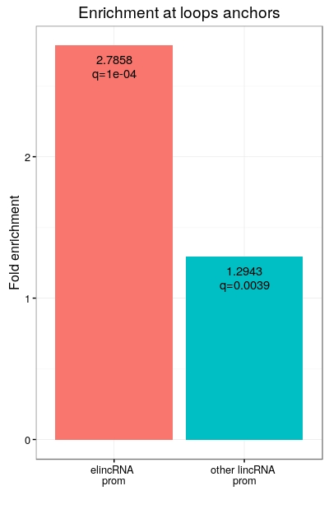
ElincRNAs are enriched at loop anchors
Promoter regions of elincRNAs are enriched at loop anchors compared to other lincRNAs
Consistent with their putative regulatory role

Slide 19
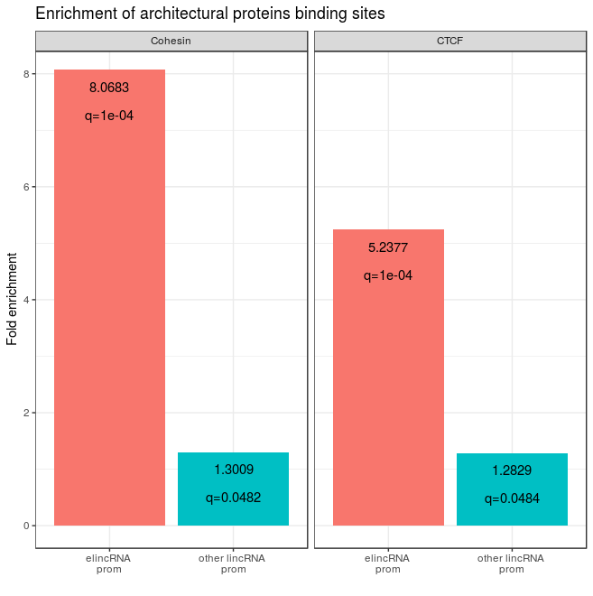
ElincRNAs enriched in architectural proteins
ElincRNAs are enriched in CTCF and cohesin (RAD21 + SMC3) binding sites.

Slide 20
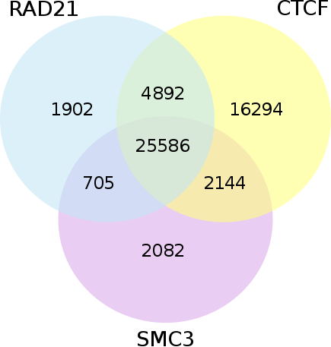
CTCF and cohesin peaks overlap
CTCF and cohesin peak regions largely overlap
Both proteins have different roles in TAD regulation
Is the enrichment still present at CTCF-only peaks ?

Slide 21
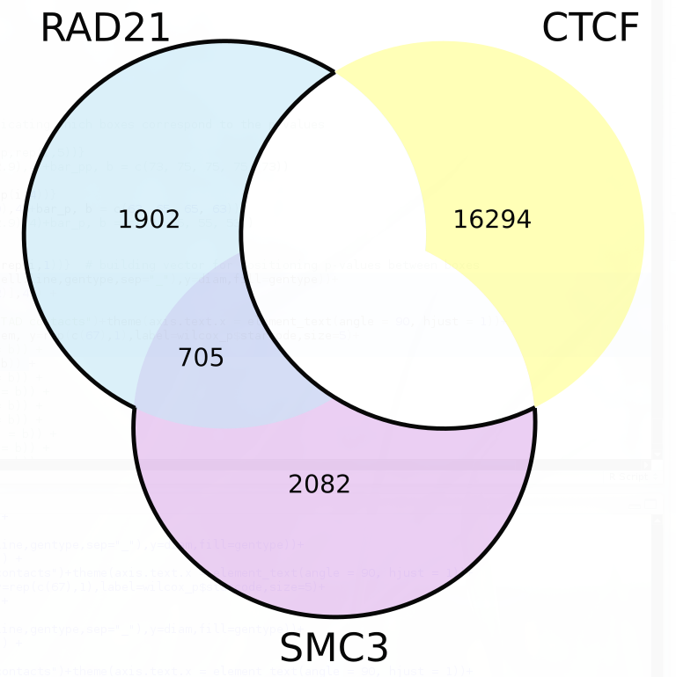
CTCF and cohesin peaks overlap
CTCF and cohesin peak regions largely overlap
Both proteins have different roles in TAD regulation
Is the enrichment still present at CTCF-only peaks ?

Slide 22
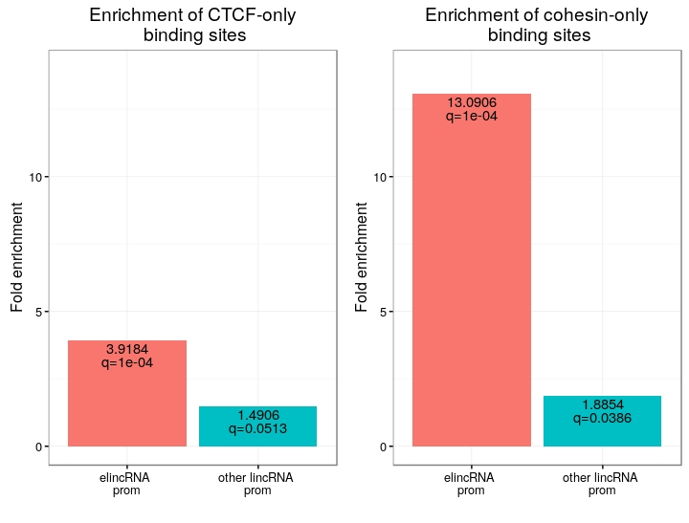
ElincRNAs strongly enriched in cohesin-only peaks
The promoter regions of elincRNAs show a very strong enrichment for cohesin-only peaks compared to other lincRNAs
This is not the case for CTCF peaks

Slide 23
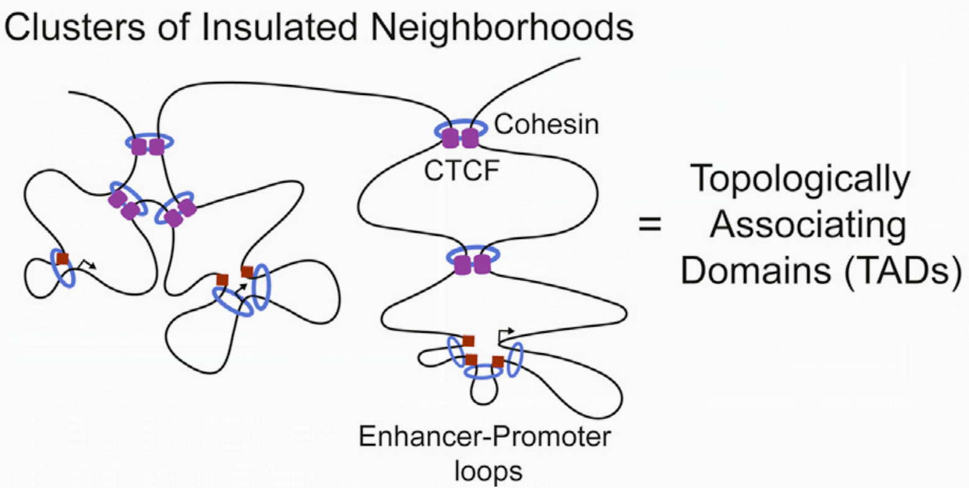
CTCF/cohesin roles in TADs
A new model for CTCF/cohesin loops in TADs was recently proposed
2 types of TAD loops:
CTCF/cohesin loops are important for structural maintenance of TADs
Cohesin-only loops are smaller promoter-enhancer loops
Ji X et al., 2016. Cell Stem Cell

Slide 24
Conclusions
ElincRNAs are enriched at loop anchors, but not significantly at TAD boundaries
Likely not involved in the maintenance of TAD boundaries
They are enriched in cohesin compared to other lincRNAs
Could be involved in enhancer-promoter looping

Slide 25
Aim 2
Are elincRNAs associated with higher chromosomal contact ?

Slide 26
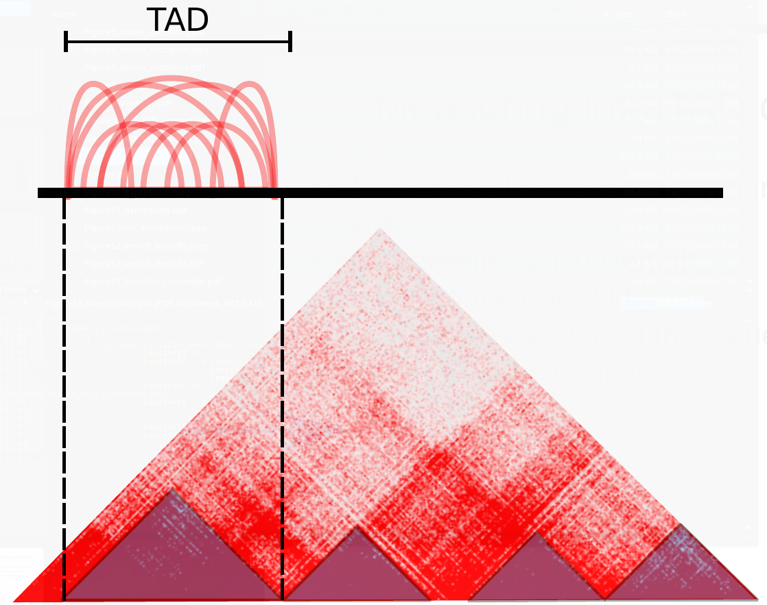
Measuring intraTAD contacts
Summing all contacts happening inside every TAD.
Normalizing by TAD length

Slide 27
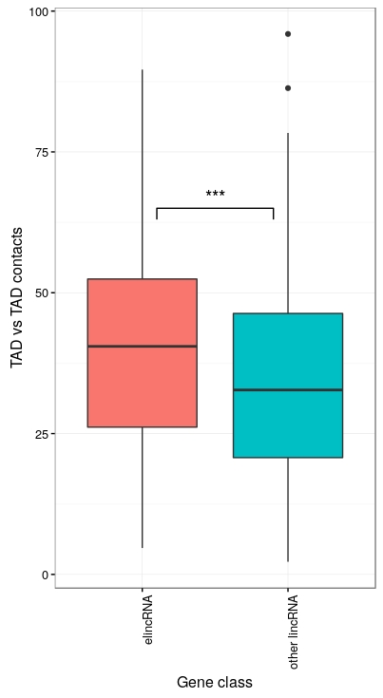
ElincRNAs associated with higher contact TADs
ElincRNAs are associated with TADs with significantly higher contact than other lincRNAs

Slide 28
Conclusions
ElincRNAs are enriched at loop anchors, but not significantly at TAD boundaries
Likely not involved in the maintenance of TAD boundaries
They are enriched in cohesin compared to other lincRNAs
Could be involved in enhancer-promoter looping
They are associated with TADs presenting more compaction
Could promote these enhancer-promoter loops

Slide 29
Outlook
Extending analysis to other cell-lines may reveal whether the role of elincRNAs in regulating chromatin architecture is cell-type specific.
Experimental validation by genetically manipulating elincRNAs transcription and testing effect on chromatin folding is required to confirm their roles.

Slide 30
Acknowledgements
Jennifer Yihong Tan
Ana Claudia Marques
Adam Alexander Smith
Maria Ferreira da Silva
Melvin Berard

Slide 31
Questions ?

Slide 32
Discussion
Ongoing debate : Transcript- or transcription-mediated functions of eRNAs in general
The mechanisms of spatial regulation by elincRNAs are probably case specific
Analysis is limited by the resolution of the technology
Only looking at intra-chromosomal contact. Interchromosomal and lamina contact might add interesting information

Slide 33
Supplementary slides

Slide 34
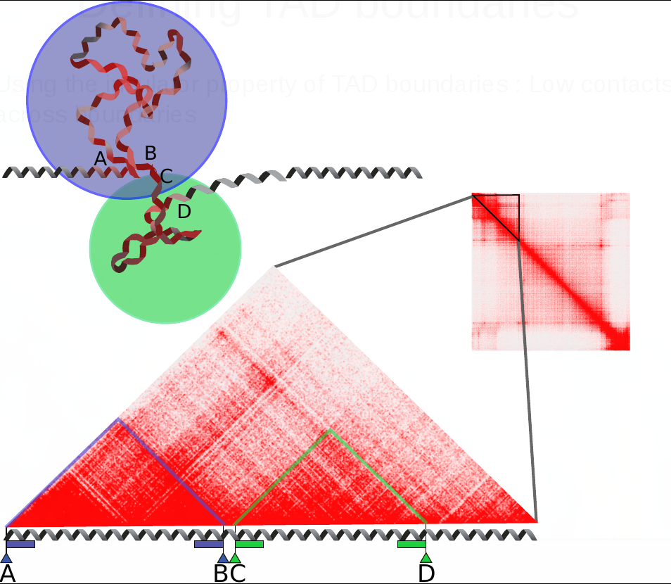
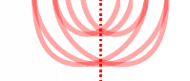
Defining TAD boundaries
Using the insulator property of TAD boundaries : Low contacts across boundaries
Extending boundaries inwards only (technical limitation)
Stop extending when the contacts reach a threshold

Slide 35
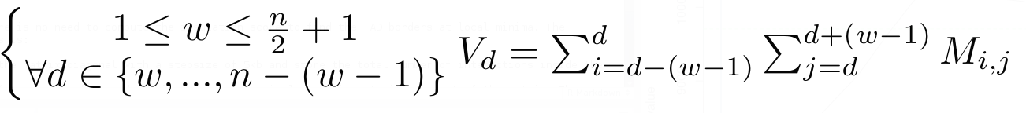
Defining TAD boundaries
Compute contacts across every position « d » in the genome at a maximum range of « w ».
Diamond of width « w » slides along the diagonal.
w : arbitrary threshold set to 100kb
V : measure of insulation for every position along the diagonal
1
n

Slide 36
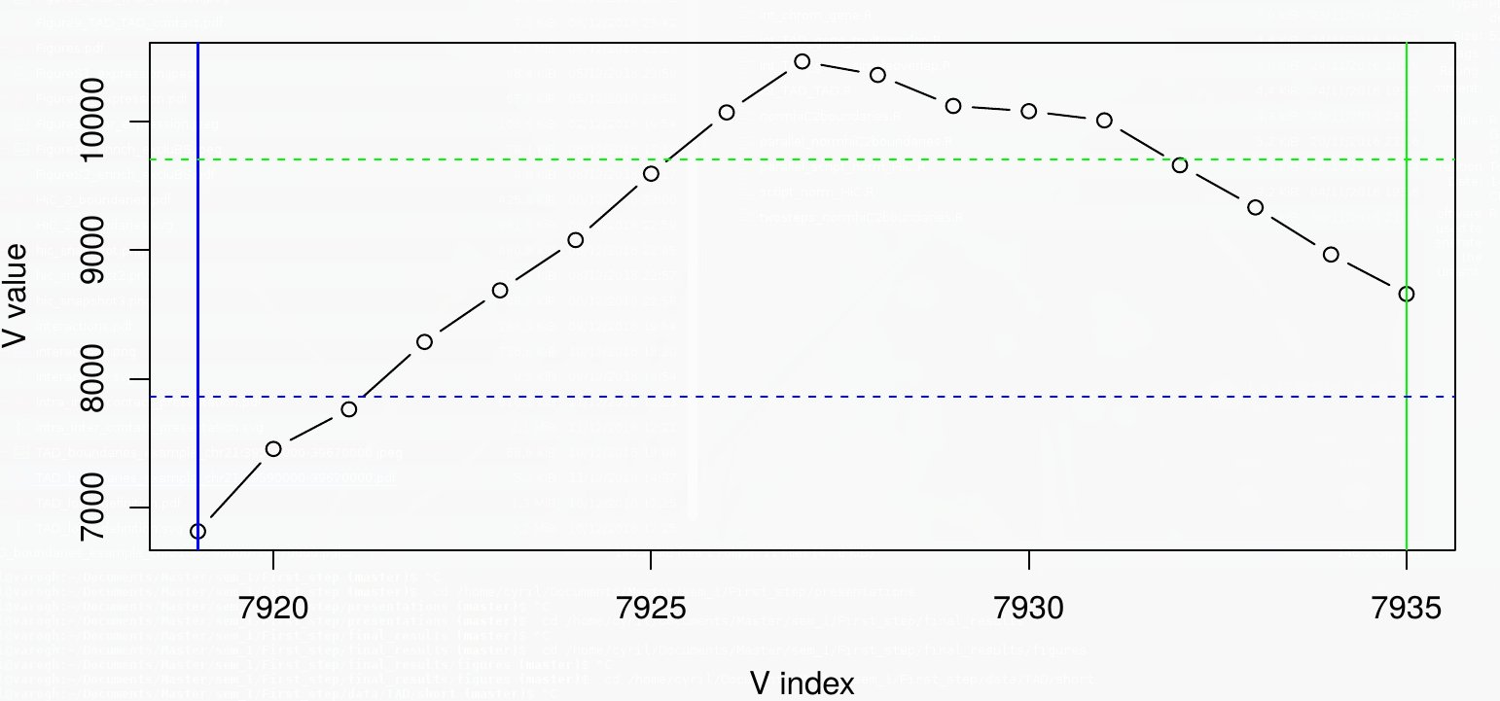
Defining TAD boundaries
For every TAD, boundaries are extended inwards from the borders until the value of V_{d} reaches a defined threshold.

